Slide 1

Human Resource Dataset
Predicting Employees Resignation
Notes:
I have worked on a Human Resource, HR dataset for my analysis and have developed a model that is able to predict the likelihood of resignation in a company.

Slide 2
Problem Statement
Employees resign for many reasons. Even healthy companies have valuable employees leaving. This can be disruptive to the operation effectiveness and costly in terms of time, money and effort to find a replacement.
By putting HR Data to work, leveraging the data can help inform early signs of resignation and also improve the HR strategies and that is including offering HR policies and practices and importantly is to retain employees.
Our approach here is to develop a predictive model to predict who will be likely to resign. This would allow HR to seize/act quicker in the effort to retain the employee rather than to find out the reason of leaving after the exit interview. That is late and done with!

Slide 3
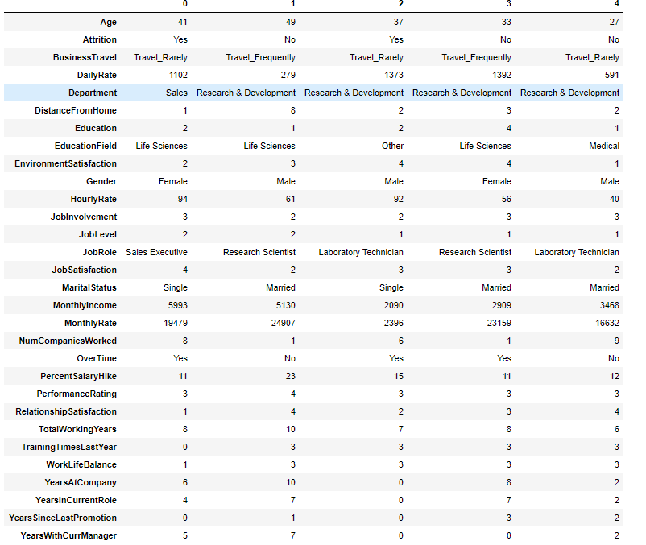
Example of Dataset
Source - https://www.kaggle.com/pavansubhasht/ibm-hr-analytics-attrition-dataset
35 Columns & 1500 Rows
Notes:
Now let’s take a look at the dataset. As you can see, there are a total of 35 columns and close to a 1,500 rows. Which means, the number of columns are sufficient to open up to a lot of possibilities of analysis. This dataset also contains the employees’ details such as age, marital status, designation, years of employment, job satisfaction rating and much more.
Resigned staff may resonate to one or more of the above features. It is necessary for HR dept to conduct a employee satisfaction survey periodically with these important features to get valuable data and insights.

Slide 4

Human Resource Dataset
(Key Features)
Employees stay or resigned
Age
Gender
Marital Status
Education
Working Hours
Overtime
Job Involvement
Business Travel
Job Satisfaction
Environment Satisfaction
Training Time
Job Position
Monthly Income
Salary Hike
Employees who resign may resonate to one of the above features or can link to a few too. HR needs to use data to identify who will stay the course or who will leave and be prepared. Employee survey is one of the strategies to get the data and analyze it.
Notes:
There are many factors that could possibly lead to resignation. Even large MNCs who have a good staff welfare may lose their valuable employees. High turnover rate may cause disruptions to operative effectiveness and costly too, in terms of time, money and efforts required to find a suitable replacement within a short time.
By leveraging on HR Data, this allows the HR department to be alert on early signs of intended resignation and possible improvements on HR management. For instance, HR can identify which existing policies and practices are making employees unhappy or what factors can effectively increase the retention rate.
My approach has developed a model to effectively predict the employees that will likely to resign which allows HR dept to respond in time in the effort to retain them rather than finding out the cause during exit interviews. That will be too late.

Slide 5
Flow of developing predictive model
1) Data Pre-Processing - Handle missing values & remove unnecessary features
2) Early Data Analysis – Get to know the data and turnover rates
3) Train Multiple Models – Naïve Bayes, K-Nearest Neighbour, Decision Tree and Random Forest
4) Use Metrics for Model Validation – Accuracy, Confusion Matrix and Recall
5) Hyperparameter Tuning - GridSearchCV
6) Feature Importance
7) Outcome & Recommendations

Slide 6
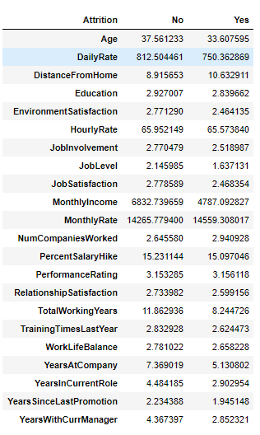
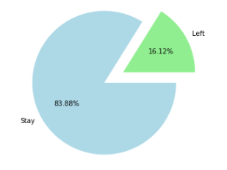
Comparison
What is the turnover rate (%)
Notes:
Now we are looking at the turnover rate of the company in %. There are 16% who have left and 83% of them who are still in this organization.
On the right, you can see the table of the average, comparing with the ones who left and stayed.
According to the table, we can tell that the employees who have lefted have less environmental satisfaction, lower job level position and monthly income compared to the ones who are still working here.

Slide 7
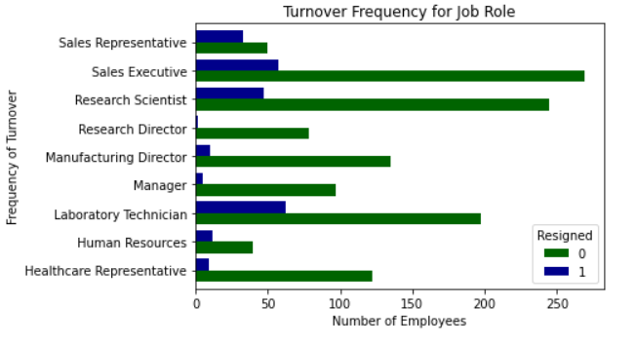
Visualizing the roles that have the highest turnover
Notes:
This is a visualization graph where we can understand which job role has the highest turnover rate. It turns out that it is the ‘Sales Representative’ designation while the company’s Sales Executive position has the lowest turnover.
It is also can be observed that the higher the job position, the less likely they will resign.

Slide 8
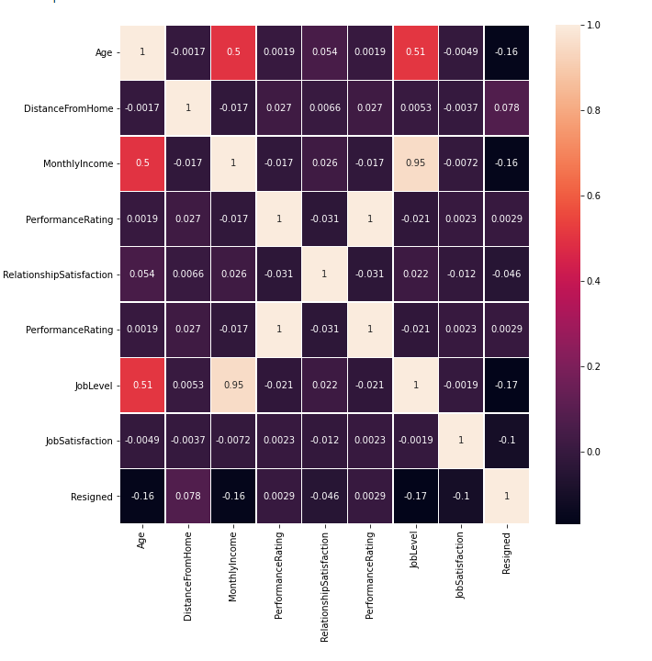
Identity factors that have impact for employee decision to resign resignation
Notes:
So I did a correlation to provide an insight of which factors that are likely affecting an employee's resignation decision.
Evaluate from slides

Slide 9
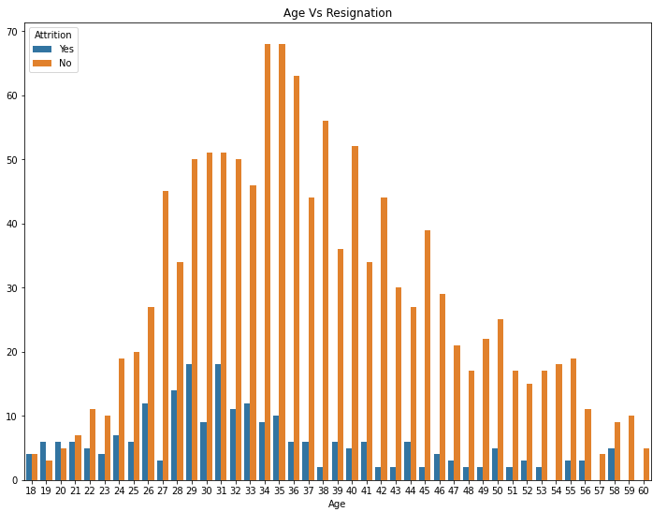
Younger employees 18 - 25 are likely to leave the company while 30 and above are less likely to leave the company.
HR should revamp the retaining strategies to keep the younger age group or can consider employee 30 years old & above.
Notes:
From the graph, we can tell that younger employees belonging to the age group of 18 - 25 are more likely to leave the company and employees who age 30 & above are less likely to leave.

Slide 10
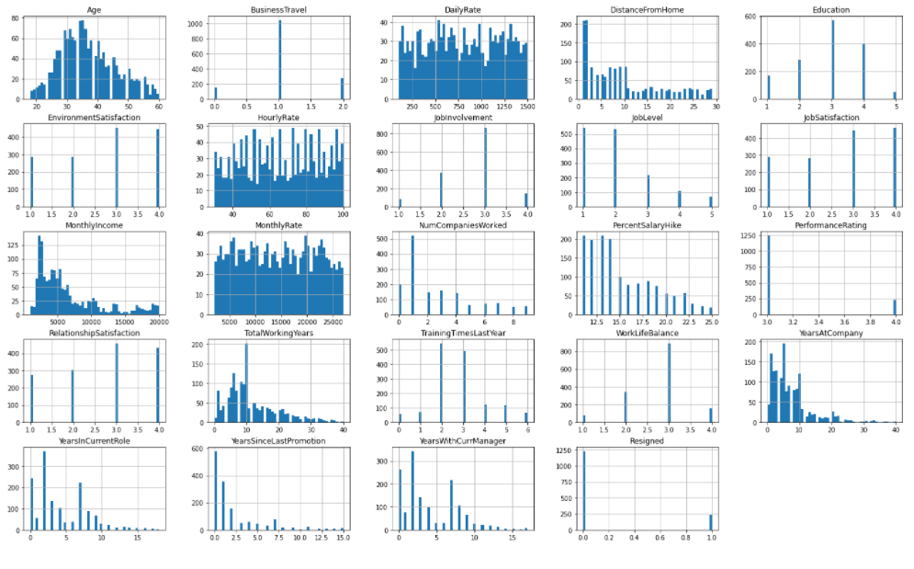
Notes:
There are many opportunities for business trips. More than half of the employees travel.
Majority of employees stay near office
Most employees are holding a Bachelor's degree and masters
Most employees are satisfied with the work environment
Most employees has high involvement in their job
In total, there are 1477 employees. Close to 500 or more employees are not satisfied with their job. But they are more people who are staying and not leaving.
Most receive up to 15% salary increment including the lower job position.
Performance rating is imbalance. From this point of view, the managers might find that most employees are underperforming.
The culture of the environment is fine as you can tell from the decent Relationship Satisfaction index.
Most feel that they have work life balance.

Slide 11
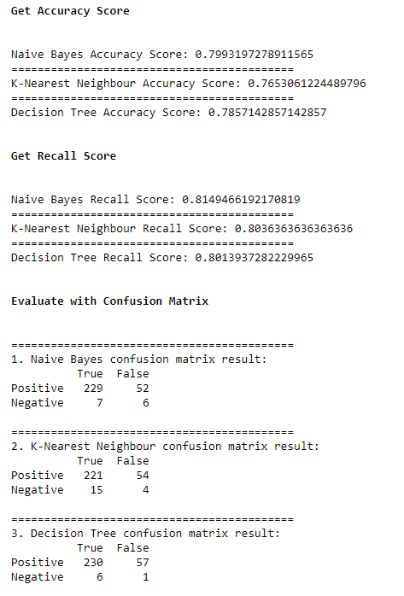
Features used in train and test dataset
features = ['Age','DistanceFromHome','MonthlyIncome', 'PerformanceRating', "RelationshipSatisfaction", 'JobLevel', 'JobSatisfaction']
Notes:
So for my case, this is a classification and supervised learning, so I am using the classification algorithm models. Before training and testing the dataset, I included the important features. After, In the train and test set, it is set to train it as 80% to fit the machine learning model and 20% as test to evaluate the fit machine learning model.
The algorithms selected Naive Bayes, K-Nearest Neighbour and decision tree. Now with the performance metrics implemented. The outcome is observed that Naive Bayes has demonstrated a better score than the rest. For the confusion matrix in Naive Bayes,it has demonstrated higher True Positive and True Negatives values while less incorrect values.
Naive Bayes may have performed better in this case because this dataset is not exactly huge and doesnt contain all possibilities and thats where noises are eliminated effectively.

Slide 12

Max-Voting Ensemble and Vote Classifier Method
Naïve Bayes
HR DATA
Labelled
K-NN
Prediction Outcome (Recall Metrics)
Decision Tree
Vote Classifier
Notes:
So I have trained a few classifiers. Now there is a ensemble method called Max Voting where I can use all the multiple classifiers to make predictions. The purpose is to reduce the prediction error and seek better performance. So again, Naive Bayes scored better and would be considered as voted to use.
Now we use Vote Classifier, and it performs slightly better than k-nearest neighbour but it did not achieve higher than Naive bayes.

Slide 13


Random Forest Training
Naïve Bayes
HR DATA
Labelled
K-NN
Decision Tree
Notes:
Now for the final part, we use Random Forest to see if it can beat Naive Bayes. Again, I combine multiple classifiers and fit into random forest and calls for the result.

Slide 14
Pick the best model:
Naïve Bayes VS Random Forest
Result = 0.9703
Result = 0.9711

Slide 15
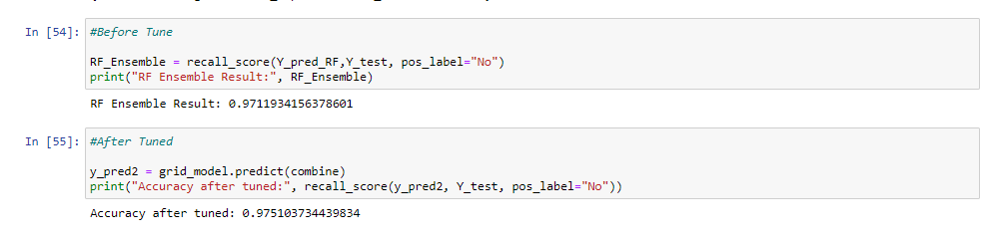
Tuning with GridSearchCV:
Increase by 0.4%
Notes:
After the Hyper Parameter Tuning, It has a 0.4% increase. Now we can move on to identify the features that can influence employee to quit.

Slide 16
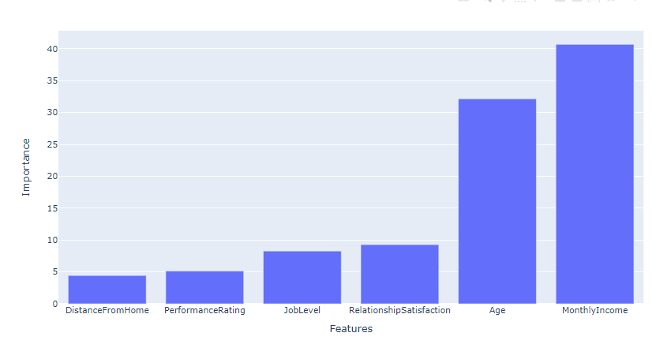
Feature Importance:
Notes:
Turns out the Monthly Income and age has the highest percentage among all the features. Based on what we have observed earlier, the young ones are likely to quit and here we can say that it is because of the monthly income that did not satisfy them.

Slide 17
Outcome & Recommendations:
Random Forest proves to be the best classifier to use and proceeded to the tuning stage where the model is optimized. Next, is to feature the importance of which factors have impact for the resignation.
HR can take note the most importance factor is the Monthly income, followed by age, relationship factors, Job Level Etc.
HR can repackage their policies that attracts younger age group and revision of the monthly income and more activities that can improve relationship in the office.

Slide 18
Thank You
https://github.com/limsweeming

